Slide 1



Car24 Dataset Presentation
Welcome to the presentation on car24 dataset. In this presentation, we will explore comprehensive data and analysis related to various aspects of cars, including performance, market trends, and consumer preferences.
by Sourabh Khandelwal

Slide 2

Introduction to Car24 Dataset
The car dataset provides a comprehensive collection of information on various car models, including performance data. It provides manufacturing year of the car, details on fuel efficiency, selling price, specification like engine, mileage, power, seats etc
It also provide ownership of car.
SIGNIFICANCE
significance of datasets in SQL-
Queries and Analysis
Data Visualization
Real-world Application
generating reports

Slide 3

Dataset Overview
Exploring Insights from CAR24
Data Sources
Variables
Data Size
The dataset consists of information from various sources, including manufacturers, dealerships, and government agencies.
It includes a wide range of variables, such as model, year, mileage, fuel type, engine, power and more.
The dataset is substantial, containing thousands of records and is updated regularly to reflect the latest market trends.

Slide 4

Methodology
1
BASIC SQL COMMANDS
SELECT, FROM , WHERE, SUM, AVERAGE, MIN, MAX ETC
2
Filtering Data
using WHERE clause and HAVING Clause
Example: "SELECT * FROM Cars WHERE Year > 2015;"
3
Aggregation Functions
Using aggregate functions: COUNT, AVG, SUM.
Example: "SELECT COUNT(*) AS TotalCars FROM Cars;"
.

Slide 5
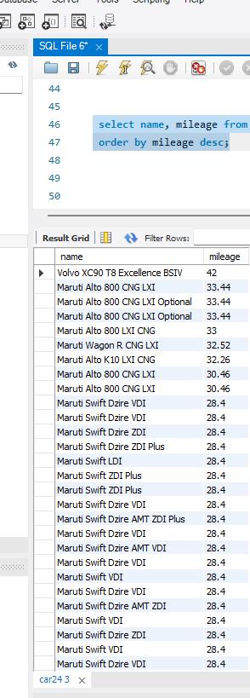
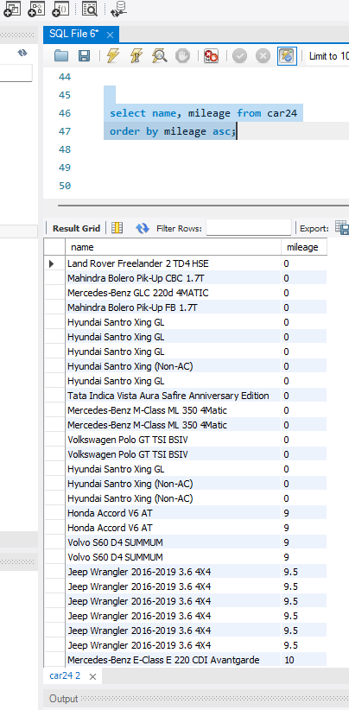
More fuel efficient cars
Less fuel efficient cars
Insights
Car Performance
Some car models may be more fuel-efficient while others may prioritize speed and acceleration. Analyzing performance data can help identify patterns and preferences among drivers.

Slide 6
Price range

Slide 7
Insights
Unveiling Trends and Patterns in car24
Most Popular Manufacturers
Trend in Car Sales Over Years
-Hyundai -bmw
-honda -renault
-Maruti -ford
2020 | 74
2019 | 583
2018 | 807
2017 | 1018
2016 | 859
2015 | 776
2014 | 621
2013 | 670
2012 | 651
2011 | 592
2010 | 394
2009 | 246
2008 | 214
2007 | 183
2006 | 124
2005 | 97
2004 | 62
2003 | 49
2002 | 27
2001 | 10
2000 | 22
1999 | 18
1998 | 10
1997 | 11

Slide 8
Average Mileage by Car Type
Hyundai- 19.79 km/l
Maruti- 21.54 km/l
Honda- 19.73 km/l
Ford- 19.98km/l
BMW- 17.45 km/l

Slide 9
Trend in Car Sales

Slide 10
Ownership of cars

Slide 11



Conclusion
Comprehensive Analysis: The car dataset has been thoroughly examined, providing a comprehensive understanding of various aspects related to automotive data.
BUYING
Valuable Insights: The exploration of the dataset has yielded valuable insights into trends, patterns, and correlations, aiding in informed decision-making.
we conclude our exploration, it is evident that this dataset serves as a foundation for data-driven decision-making, empowering stakeholders to make informed choices that can drive success in the ever-evolving automotive landscape.
YEAR WISE

Slide 12
FUTURE WORK
M
MORE POTENTIAL OF SELLING CARS --- PRICE RENGE - ACCORDING TO DATABASE 2L TO 5L
MILEAGE MUST HAVE MIN 19-20 KM/L

